Slide 1
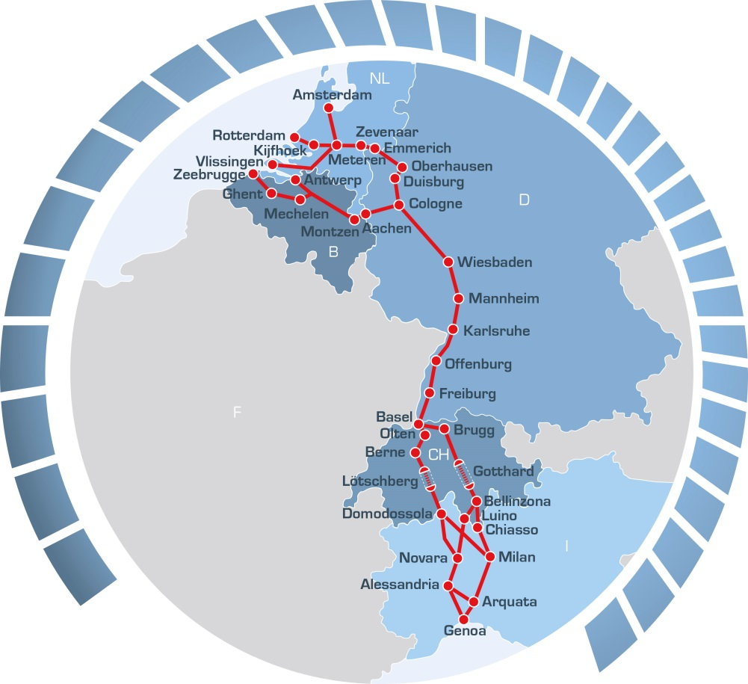
A cooperation between
RFC Rhine-Alpine – cooperation for improved international services and growth on rail
Christiane Warnecke
Managing Director
May 2017

Slide 2
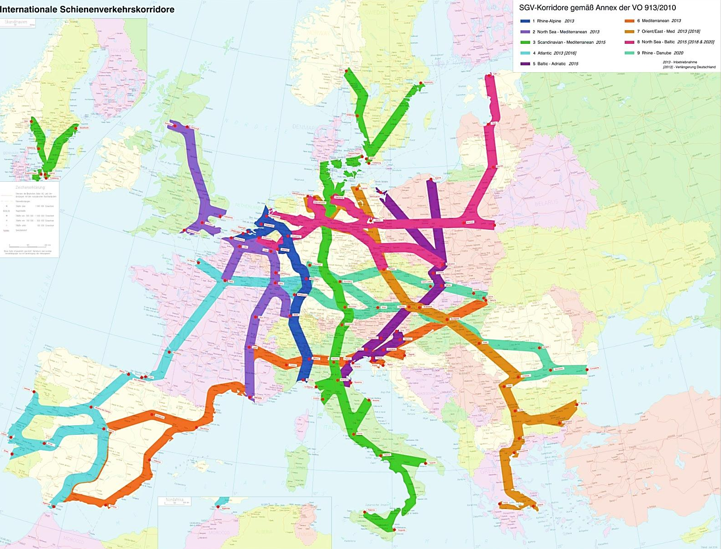
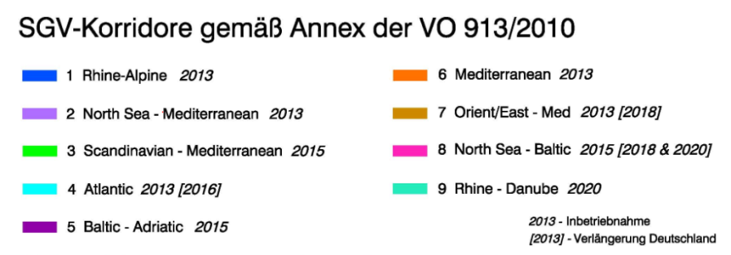
Nine Rail Freight Corridors are implemented in Europe – obligation from European Regulation 913/2010
Austauschen – neue Karte DB Netz
European Rail Freight Corridors
European Rail Freight Corridors
Routes are similar to, but not identical with TEN-T / Core Network Corridors
Chart No. 2

Slide 3
Rail Freight Corridor Rhine-Alpine covers the most important transport axis in Europe
Corridor overview
Facts and figures
Track kilometres: 3.900 km in total
6 Sea Ports The two biggest European sea ports: Rotterdam & Antwerp,
Other important ports like Zeebrugge, Amsterdam, Flushing, Genoa
More than 10 Inland Waterway Ports in DE: Duisburg, Neuss, Cologne, Mainz, Mannheim, Ludwigshafen, Germersheim, Karlsruhe
100 Terminals
Number of Trains at Borders 2016, e.g.
Emmerich/Venlo: 37.000
Aachen: 22.000
Basel: 54.000
Domo/Luino/Chiasso: 48.000

Slide 4
Very different conditions for rail traffic on northern and southern part of Rail Freight Corridor Rhine-Alpine
Very high volumes from Rotterdam Port and also from the Port of Antwerp with distribution to hinterland and especially to highly populated Rhine-Ruhr area in Germany
Rail share of hinterland container traffic is around 10% of TEU, Rotterdam and Antwerp both aim for shares of 15-20% until 2030/2035
Inland waterways with highest market share on total corridor: 54%
Strong political support of rail in Switzerland, e.g.
No night traffic on road
Reduced path prices until 2021
Massive investments in rail tunnels and other infrastructure for efficient rail transport (NEAT, GBT)
Main volumes from southern Germany, Belgium and The Netherlands to intermodal terminals and industrial centres in Northern Italy
Rail covers about 70 % of trans alpine traffic (in % of net tons) – competition almost only with road
Sources: Transport Market Study 2013, Annual Report 2015

Slide 5
Rail on RFC Rhine-Alpine has a focus on intermodal transport; bulk rather volatile due to IWW competition
Rail on RFC Rhine-Alpine
Share of train runs
Share of train kilometres
Wagonload (bulk) 13%
Wagonload (bulk) 20%
Single Wagonload 14%
Intermodal 56%
Intermodal 73%
Single Wagonload 24%
Characteristics of intermodal traffic:
Key choice of intermodal operators: cost, transport time, flexibility
Strong growth rates
Relatively long train runs on corridor
Train lengths as limiting factor
Characteristics of bulk traffic:
Key choice of logistic operators: cost, (rail cost are up to 200% of IWW costs)
Rail often has strategic background function to IWW for incidents e.g. low water
Therefore high share of ad hoc traffic demand
Source: Transport Market Study 2013
Chart No. 5

Slide 6
Organisational of RFC Rhine-Alpine: We bring all relevant stakeholders together
Governance structure of RFC Rhine-Alpine
SCHEMATIC
Executive Board - ExB
bodies according to Regulation
Representatives of the ministries
Defining and monitoring the general goals of the corridor
structure decided by MB
Railway / Terminal Advisory Groups – RAG / TAG
Management Board - MB
Corridor-One Stop Shop -
C-OSS
Railway undertakings and terminals connected to the corridor
RAG / TAG speaker invited for specific topics to MB and ExB
Infrastructure manager (IM) and allocation bodies of our corridor
Main decision board
IMs appoint C-OSS
Responsible for the allocation of Pre-arranged paths (PaPs) on the corridor
MD / office / PMO
Joint office with 4 team members
Plus corridor coordinators at IMs (PIMs)
WGs on infra-structure and ERMTS
WGs on performance management
WGs on international path product
WG on coordination of works / TCR
Other/temporary WGs….
With Experts from all corridor IMs/AB
Chart No. 6

Slide 7
Main focus of current work in RFC Rhine-Alpine:
create added value for customers with five priority topics
Mission RFC Rhine-Alpine: We create added value for our customers
in international rail freight and support modal shift
General approach
Work priorities / main objectives
We focus on customer related topics
We involve our customers early in the process
We work in a pragmatic way
We improve our capacity product
We increase quality of performance in international rail freight
We improve coordination of works/TCR
We harmonise terms & conditions, procedures, etc. related to IMs and RUs (help of MoTs and NSAs needed)
We support the improvement of quality and capacity of infrastructure and of interoperability/ERTMS
+
© RFC Rhine-Alpine, May 2017

Slide 8
Train length: big progress in 2021, but full benefit with 740m trains only after upgrading of all RFC lines
740 m
?
Standard: 670-690 m, few trains with 740m
690 m
Projects in DE and BE are not yet scheduled and financed
Standard: 650 m
up to 740 m with special permission/not during peak hours
650 m
max. 150 m
min. 70 m
600 m
Projects in CH and IT are scheduled and financed
540 m - 625 m
*Assumed average value
2016
2017
2018
2019
2020
2021
Future
RFI and SBB prepare for regular operations with 740 m long trains until the end of 2020/21
As long as 740 m is only possible for very few trains in Belgium and Germany, an estimated variable of 50 – 70 m train length can mostly not be used on main parts of the Corridor
© RFC Rhine-Alpine, May 2017

Slide 9
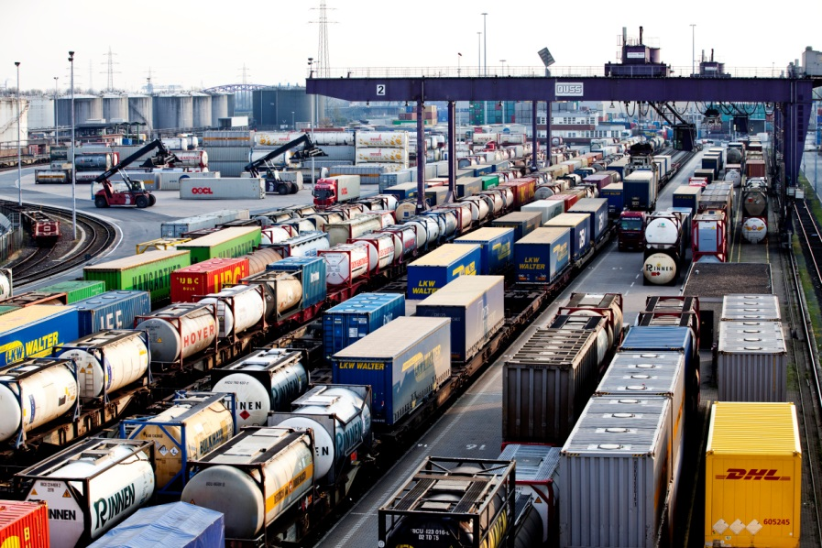
Thank you for your attention!

